Slide 1
Amazin Black Box Drone Deliveries
Group #2 - ITEC 625 - Dr. Steven Wright
Juline Kerr, Debashis Jena, Ken Kallon, Ansoo Chang, Pablo Hernandez
Due - December 1, 2019

Slide 2
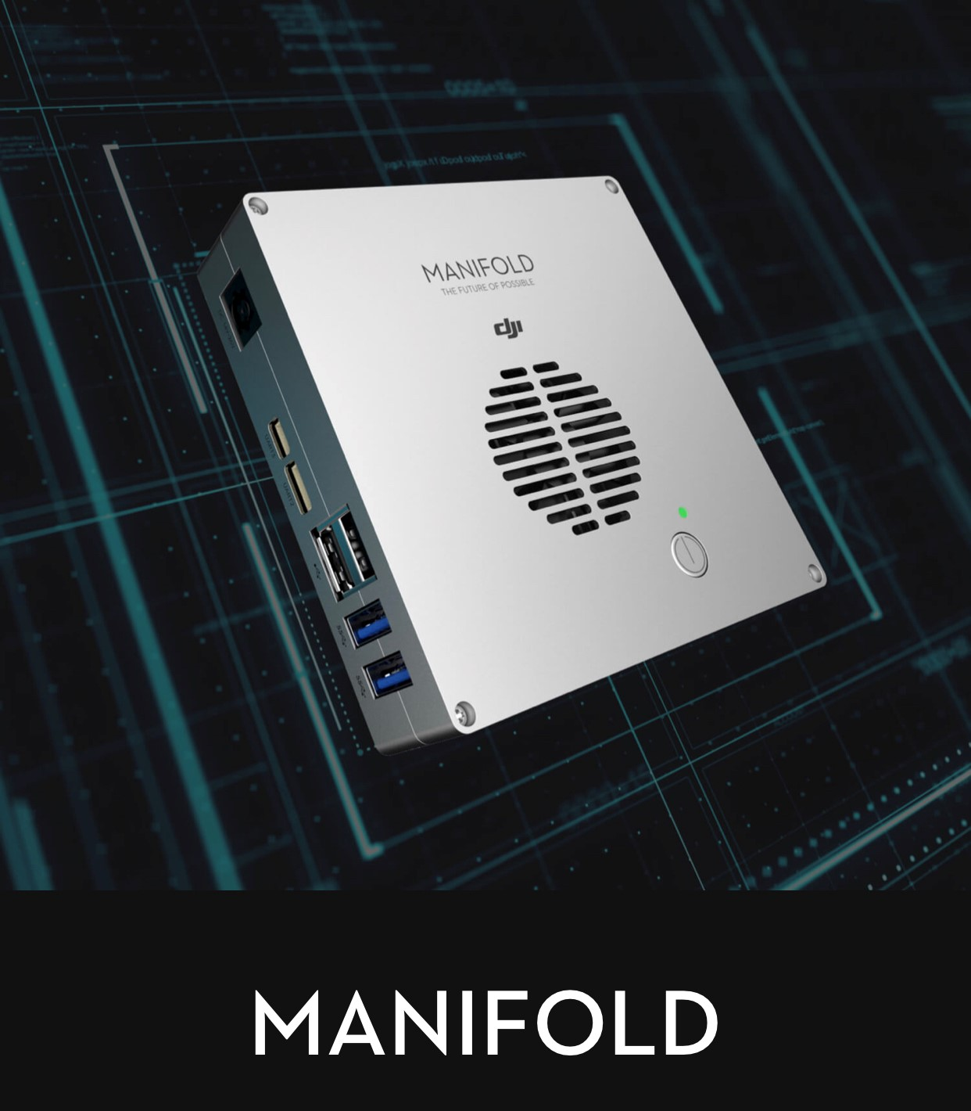
Juline Kerr Slide - Drone - GPU & CPU
NVIDIA Kepler GPU
Contains 192 CUDA Cores in each SMX - Speeds up to 2.2 GHz
Manifold Tegra K1 CPU - High Performance
Low Power Consumption - Peak 15 Watts
Used in Artificial Intelligence Applications
Limited Space Compliant
11cm x 11cm x 2.6cm
Weight = <200g
Compatible with A3 & N3 Flight Controller
Images & Content Courtesy of DJI Inc.

Slide 3
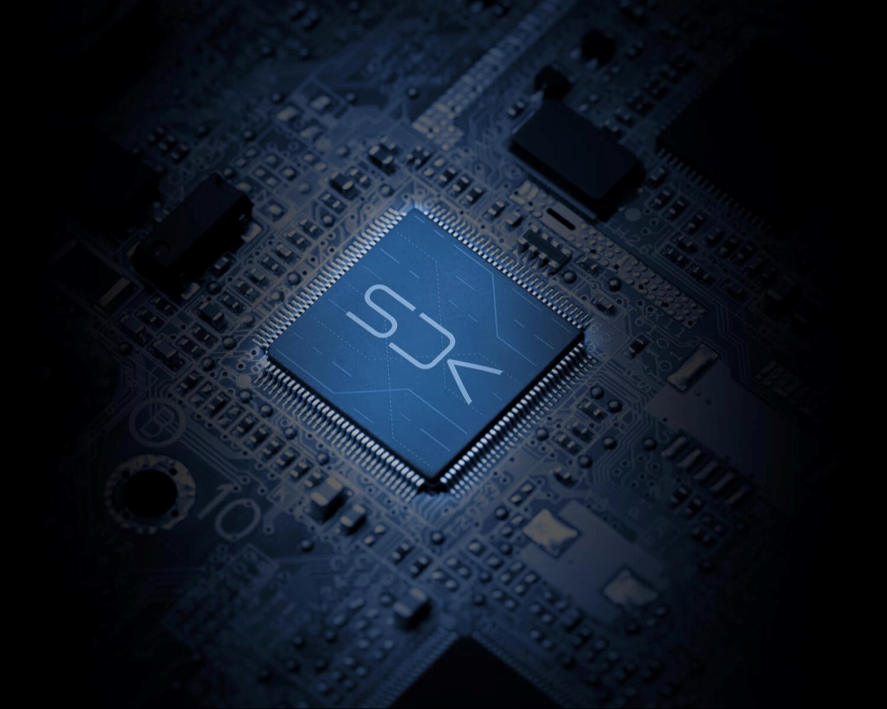
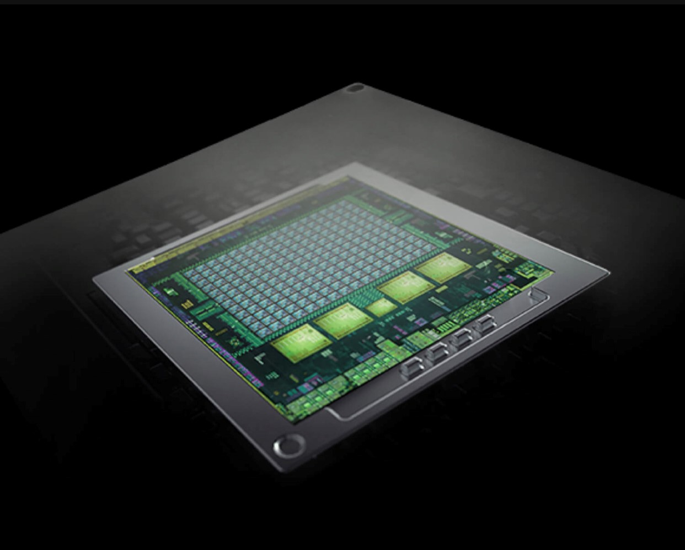
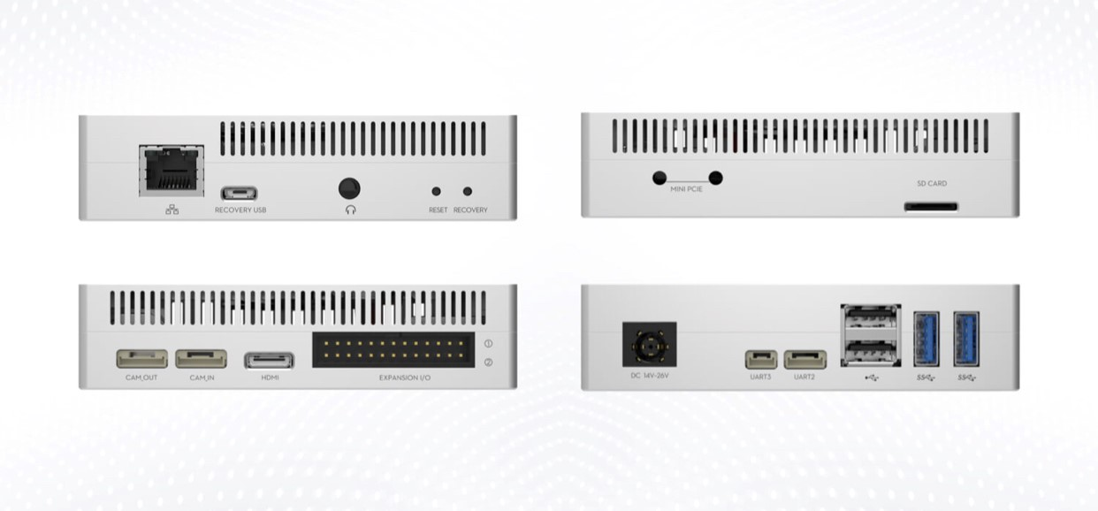
Juline Kerr Slide - Drone - GPU & CPU (cont’d)
Manifold, cont’d
Designed for DJI Onboard SDK - Image 1
Access Flight Data
Perform Intelligent Control & Data Analysis
Enables developers to transform aerial platforms into intelligent flying robots
Performs complex computing tasks and advanced image processing instantaneously
NVIDIA Tegra K1 - 4-Plus - 1 Quad Core ARM Cortex A15 Processor - Image 2
Equipped with USB, Ethernet, Mini-PCIe, HDMI, UART, & I2C Ports - Image 3
Customizable Ports - Connect Matrice 100 & Matrice 600 - Processing Images
Images & Content Courtesy of DJI Inc.

Slide 4
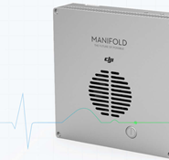
Juline Kerr Slide - Drone - CPU
Manifold Tegra K1 CPU
Uses (4) A15 Cores for heavy computing
Single Battery-Saver Core for lighter applications
Active Cores can be adjusted for decreased power consumption
Extra Core is automatically activated depending on the need
Images & Content Courtesy of DJI Inc.

Slide 5
Juline Kerr Slide - Drone - Operating System
Manifold - Built In Ubuntu Operating System
Supports Linux, CUDA, OpenCV & ROS
Operating System Utilized for Drone is Linux
Open Source Operating System
Manages Peripherals like CPU, Memory (RAM) & Storage (RedHat, n.d.)
Sits Between Applications & Hardware Connecting All Software & Resources (RedHat, n.d.)
Includes GNU Tools, Kernels, System User Space & Applications (RedHat, n.d.)
Free to Install & Run (Linux, n.d.)
Free to Study the Program and Inner Workings (Linux, n.d.)
Free to Modify Programming & Customize Settings (Linux, n.d.)
Free to Redistribute Including Modified Versions (Linux, n.d.)

Slide 6
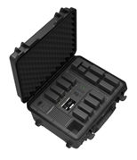
Juline Kerr Slide - Drone Battery & Speed Controls
“Storage space for up to 12 TB50 Intelligent Batteries, two CrystalSky/Cendence Intelligent Batteries and one CrystalSky/Cendence Battery Charging Hub” (DJI Store, n.d.)
“Charge up to eight TB50 batteries simultaneously. Multiple ports let you also charge the Inspire 2 remote controller, CrystalSky/Cendence Intelligent Battery, and a mobile device (DJI Store, n.d.)”
“A built-in cooling fan ensures every battery stays within a safe range. The Battery Station automatically cancels charging and discharging to avoid any safety hazards when overheating is detected” (DJI Store, n.d.)
Images & Content Courtesy of DJI Inc.

Slide 7
Ken Kallon Slide

Slide 8
Ken Kallon Slide

Slide 9
Ken Kallon Slide

Slide 10
Ken Kallon Slide

Slide 11
Ken Kallon Slide

Slide 12
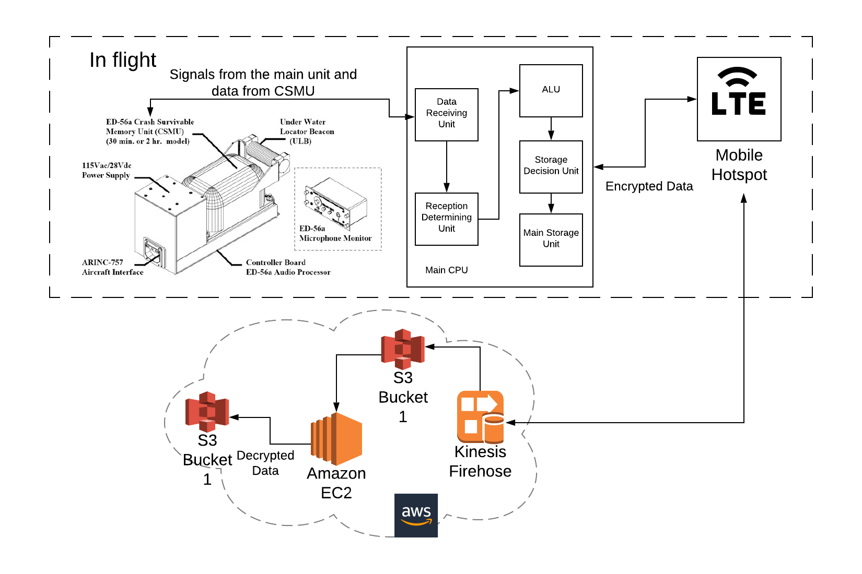
Debashis Jena Slide - FDR Communication Overview
CPU - processes the videos and data recorded for each of the events in the drone in the CSMU
LTE mobile hotspot device helps the black box connect to internet
Data and video files are periodically transferred to the AWS cloud server and event data streamed continuously
AWS captures the streaming data and saves in S3 bucket
APIs hosted in AWS EC2 servers process and saves the event log in a database for any further analytics
Notes:
The flight data recorder (FDR) that records parametric data such as altitude, airspeed and heading.
Reference:
Oei, M (March, 2014) How The Black Box Works And Why It's In Need Of New Technology, Retrieved from https://says.com/my/lifestyle/facts-and-information-about-black-boxes-or-fdr

Slide 13
Debashis Jena Slide - Crash Survivable Memory Unit (CSMU)
Receives vehicle, subsystem and environmental parameters from a data bus
Stores in uncompressed form in EEPROM solid-state memory
Aluminum housing - There is a thin layer of aluminum around the stack of memory cards.
High-temperature insulation - Made of Dry-silica material keeps the memory boards safe during post-accident fires
Stainless-steel Or Titanium shell is used to create the outer armor
Can survive crash impact, pin drop, static crush, fire, water submerge
Notes:
CSMU
What are they made of? The crash-survivable memory units (CSMUs) of the FDRs and cockpit voice recorders have an aluminium housing, high-temperature insulation and stainless-steel shell.
Data from the virtually crash-proof boxes is recorded to solid-state drives—these allow the data recorders to track thousands of parameters and have increased how long the voice recorders can record audio.
References:
Faubert, N. (March, 2014) Secrets inside an airplane’s black box, Retrieved from https://www.e dn.com/electronics-blogs/all-aboard-/4429492/Secrets-inside-an-airplane-s-black-box

Slide 14
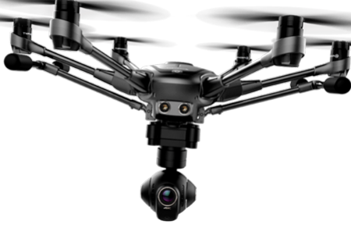
Debashis Jena Slide - Video and Data Recording
6 high-definition cameras, fit to the drone record continuous flight video from each direction
Video from the drone to the controller console is live streamed
Live Streamed videos are saved in the CSMU asynchronously for all the cameras with a naming convention - <camera_name> + <time_stamp>
CPU within the black box polls for new videos every interval of 30 to 60 seconds
Altitude and location coordinates are recorded by the CPU every 250 milliseconds
Drone with 6 cameras
Notes:
The drone needs 6 high definition cameras to capture video from all the directions. The CPU within the drone saves the videos in an unique format.
To have a unique name, a specific nomenclature needs to be followed which is possible by simply using the current date and time as the name.

Slide 15
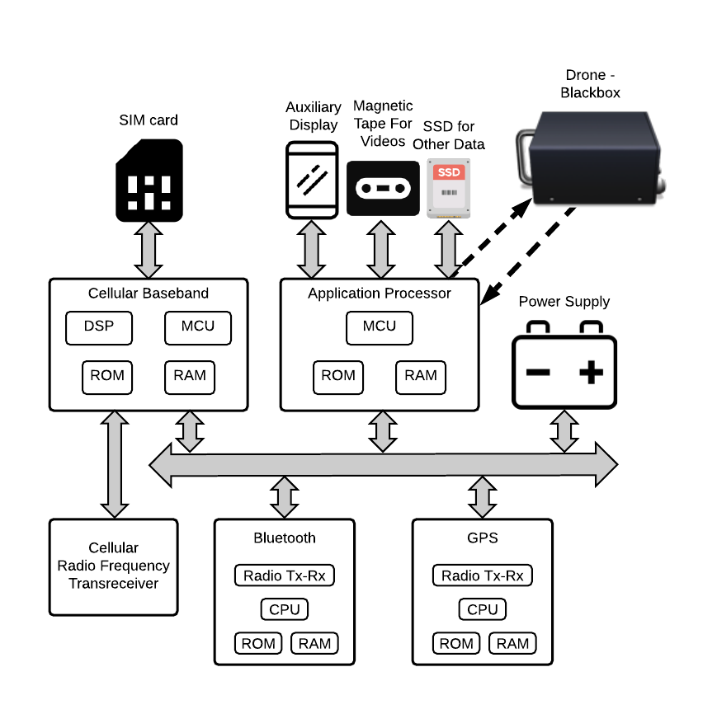
Debashis Jena Slide - Cellular Portable Hotspot (LTE)
FDR data saved in main memory
Separate power supply for the cellular device from the Black Box
Data processed as per the transmission protocol
SIM card for cellular communication for LTE service
Constant communication between Blackbox and the server using Cellular RF (Radio Frequency) Transreceiver
Magnetic Tape to save video and an SSD to save other flight data, like events, altitude and coordinates
Optional Bluetooth for connecting peripheral devices
Notes:
To communicate over the cellular network, the drone blackbox LTE architecture will follow the same architecture as in a smart phone.
The blackbox within a drone needs to possess the following items.
SIM card slot
Application processor to process the FDR data
Cellular baseband communicates with the cellular networks
SSD for high speed data storage and magnetic tapes for the videos
Power supply
Other additional features like bluetooth and GPS
Reference:
Bailoo, A.S. (June, 2019) A Quick Introduction to Smartphone Architecture, Retrieved from https://www.evelta.com/blog/a-quick-introduction-to-smartphone-architecture/

Slide 16
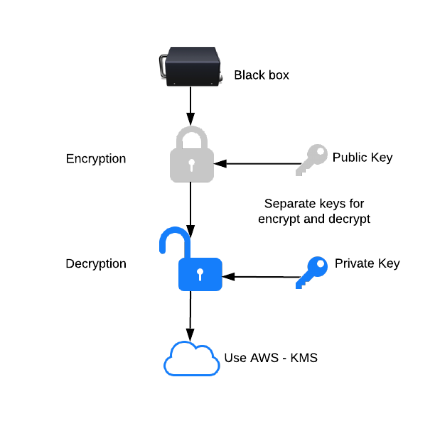
Debashis Jena Slide - Encryption/Decryption - End-to-End
Data encrypted using a public key that is stored in AWS cloud in Secrets Manager service
128 bit encryption technique is used
Data pushed to Kinesis Firehose in AWS, which creates fragmented data files in S3
Backend code runs to decrypt the data in the first S3 bucket using the 128 bit private key and store it in the second S3 as plain files
For archived data, AWS KMS (Key Management Service) can be utilized to encrypt the data while at rest
Notes:
There are many ways to achieve end-to-end data encryption.
An example of data encryption-decryption can be illustrated as follows.
A clearly readable message (“hello mum”) is encrypted into a scrambled message that is incomprehensible to anyone looking at it (“OhsieW5ge+osh1aehah6”).
The encrypted message is sent over the Internet, where others see the scrambled message, “OhsieW5ge+osh1aehah6”
When it arrives at its destination, the intended recipient, and only the intended recipient, has some way of decrypting it back into the original message (“hello mum”).
Reference:
No Author, (November, 2018) Surveillance, Self-Defense, Retrieved from https://ssd.eff.org/en/module/deep-dive-end-end-encryption-how-do-public-key-encryption-systems-work

Slide 17
Pablo Hernandez Slide - Dropped Class
Video recording, save on inbuilt memory in 3gp or mp4 format, save it in cloud periodically

Slide 18
Pablo Hernandez Slide - Dropped Class
Video recording, save on inbuilt memory in 3gp or mp4 format, save it in cloud periodically

Slide 19
Pablo Hernandez Slide - Dropped Class

Slide 20
Pablo Hernandez Slide - Dropped Class

Slide 21
Pablo Hernandez Slide - Dropped Class

Slide 22

Ansoo Chang Slide - Black Box Operating System
Use Linux operating system
Open source
Source code is available for use
Unlimited customization
Free to use
Stable and proven
Universal compatibility
Large community of developers
Source: Wikipedia (n.d.) Linux. Retrieved from https://en.wikipedia.org/wiki/Linux

Slide 23
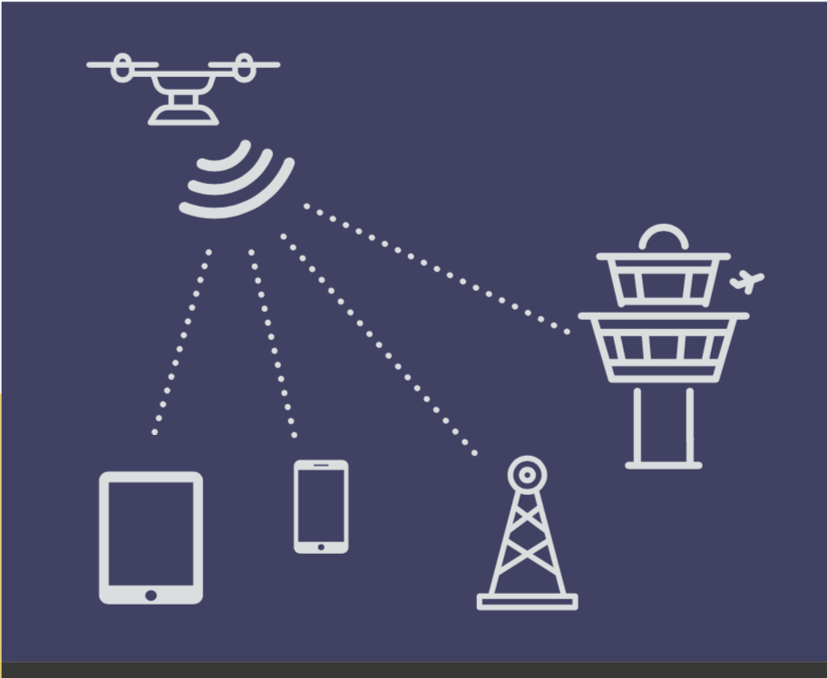
Ansoo Chang Slide - Remote ID
Remote ID, or the ability to identify and establish ownership of a DRONE from a distance.
Digital license plate for drone
Transmit a signal with remote ID
Signal is consumed by receivers
Remote ID establishes identity of drone
Source: Kittyhawk (n.d.). Remote ID & Commercial Drones. Retrieved from https://kittyhawk.io/remote-id/
ddf
D.
ssdsds

Slide 24
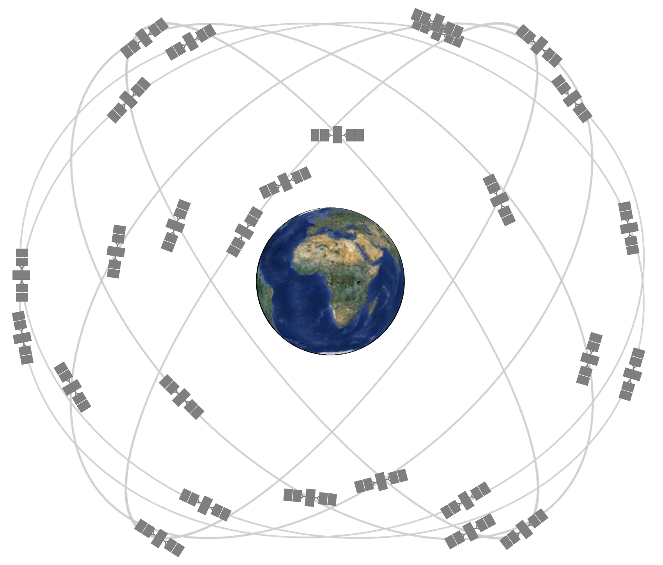
Ansoo Chang Slide - GPS
Global positioning system (GPS) for designated delivery location
Autonomous delivery of package using GPS
Receiver collects signal from satellites to determine position, speed and time
Autonomous navigation using GPS
Universal coverage for accessibility
Source(s):
Wikipedia (n.d.). Unmanned Arial Vehicle. Retrieved from https://en.wikipedia.org/wiki/Unmanned_aerial_vehicle
Wikipedia (n.d.). Global Positioning System. Retrieved from https://en.wikipedia.org/wiki/Global_Positioning_System

Slide 25
Ansoo Chang Slide - GPS Settings / AS
Conditional awareness to avoid mid air collision and other accidents
Use lasers and sensors to construct a map of its surroundings
Software uses inputs from sensors to navigate away from impending collisions

Slide 26
Ansoo Chang Slide - Missing Design Parameter Considerations / AS
General Liability Insurance
Safe landing system in case of emergency landing
Other insurance considerations

Slide 27
References
DJI. (n.d.). Manifold. Retrieved from https://www.dji.com/mobile/manifold
DJI Store. (n.d.). DJI Battery Station. Retrieved from https://store.dji.com/product/inspire-2-battery-station?set_country=US&utm_source=google&utm_medium=cpc&utm_campaign=US%20-%20SHOP%20-%20SSC&gclid=EAIaIQobChMIkOThrav85QIVCtvACh1Gzw-0EAQYBCABEgInnvD_BwE
Linux. (n.d.). What is Linux? Retrieved from https://www.linux.com/what-is-linux/
RedHat. (n.d.). What is Linux? Retrieved from https://www.redhat.com/en/topics/linux/what-is-linux
Oei, M (March, 2014) How The Black Box Works And Why It's In Need Of New Technology, Retrieved from https://says.com/my/lifestyle/facts-and-information-about-black-boxes-or-fdr
Faubert, N. (March, 2014) Secrets inside an airplane’s black box, Retrieved from https://www.e dn.com/electronics-blogs/all-aboard-/4429492/Secrets-inside-an-airplane-s-black-box
Bailoo, A.S. (June, 2019) A Quick Introduction to Smartphone Architecture, Retrieved from https://www.evelta.com/blog/a-quick-introduction-to-smartphone-architecture/
No Author, (November, 2018) Surveillance, Self-Defense, Retrieved from https://ssd.eff.org/en/module/deep-dive-end-end-encryption-how-do-public-key-encryption-systems-work

Slide 28
References

